Slide 1


Project-5
IMDb Movie Analysis

Slide 2
Description:
This project is about the IMDB movie analysis based on different criteria. We have IMBD’s dataset for different movies, which contains many information and we have to analyze the dataset using the questions that where asked.
Analysis done for the following questions:
Cleaning the data
Movies with highest profit
Top 250
Best Directors
Popular Genres
Charts

Slide 3
Approach:
We have to clean the given datasets which contains tables that contain information regarding various fields related to movies to be rated by IMDB. We have to go through the dataset closely and then executed various queries to extract the required insights from the dataset that was cleaned.
Tech/Tools used:
PPT – To prepare a detailed report.
EXCEL – Excel was used to perform entire analysis.

Slide 4
Insights:
Cleaning the data:
1. Dropping unnecessary columns.
(Color, director_facebook_likes, actor_3_facebook_likes, actor_2_name, actor_1_facebook_likes, cast_total_facebook_likes, actor_3_name, facenumber_in_posts, plot_keywords, movie_imdb_link, content_rating, actor_2_facebook_likes, aspect_ratio, movie_facebook_likes)
2. Remove Blank Cell / Null Value.
3. Removing Duplicate.

Slide 5
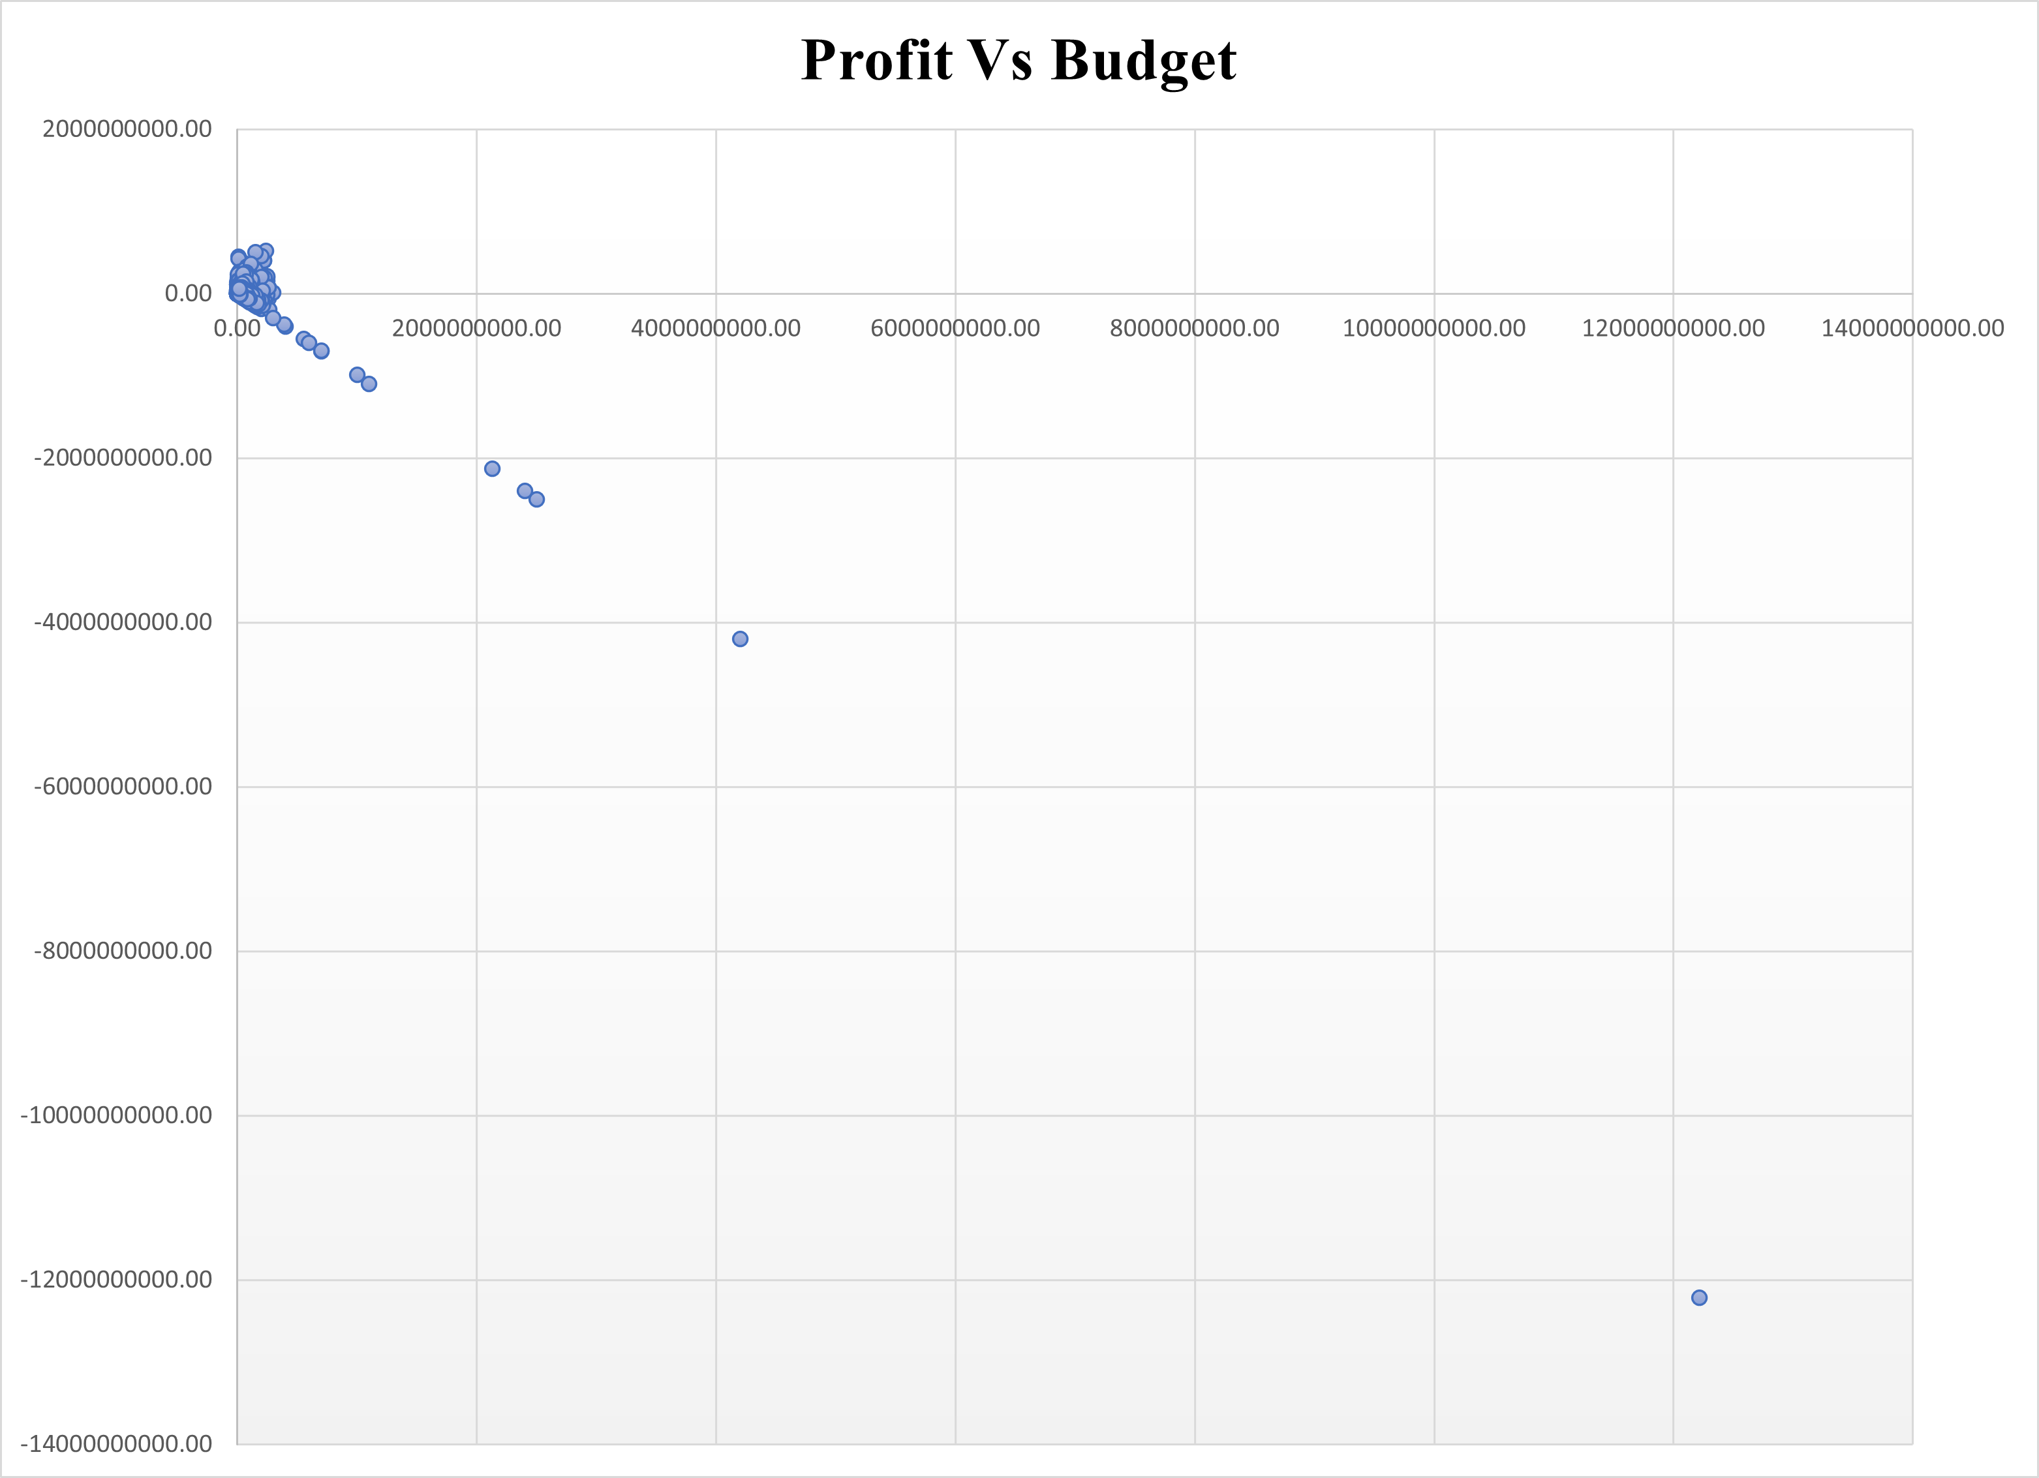
B. Movies with highest profit:

Slide 6
OUTLIERS:
-12213298588
-4199788333
-2499804112
-2397701809
-2127109510

Slide 7
Top 5 Highest Profit:

Slide 8
C. Top 250:
1.Filtering the data where num_voted_users > 25,000.
2.Sort the data using imbd_score column in largest to smallest score.
3.Create column ‘Rank’ for top 250 movies.
4. Use Sequence Formula to Rank.
5.Formula =SEQUENCE(COUNTA(G2:G251),1,1,1)
6. Filter out language by unselecting English to extract the top foreign language movie.

Slide 9
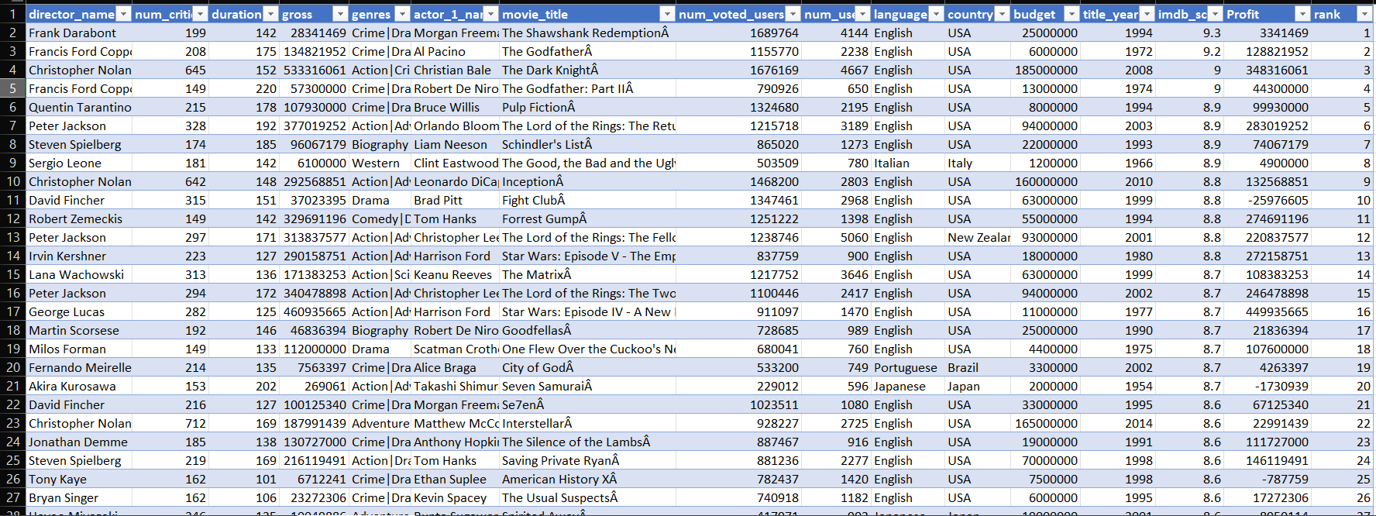
Top 250 Movies

Slide 10
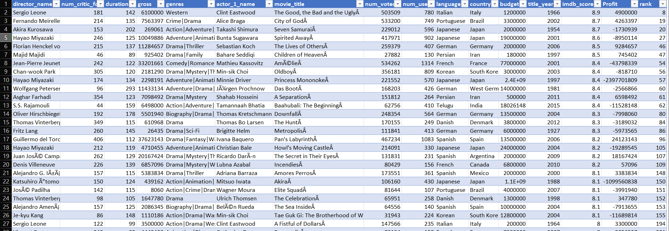
Top Foreign Language Movies

Slide 11
D. Best Directors:

Slide 12
E. Popular Genres:

Slide 13
F. Charts:
1.Highest Mean

Slide 14
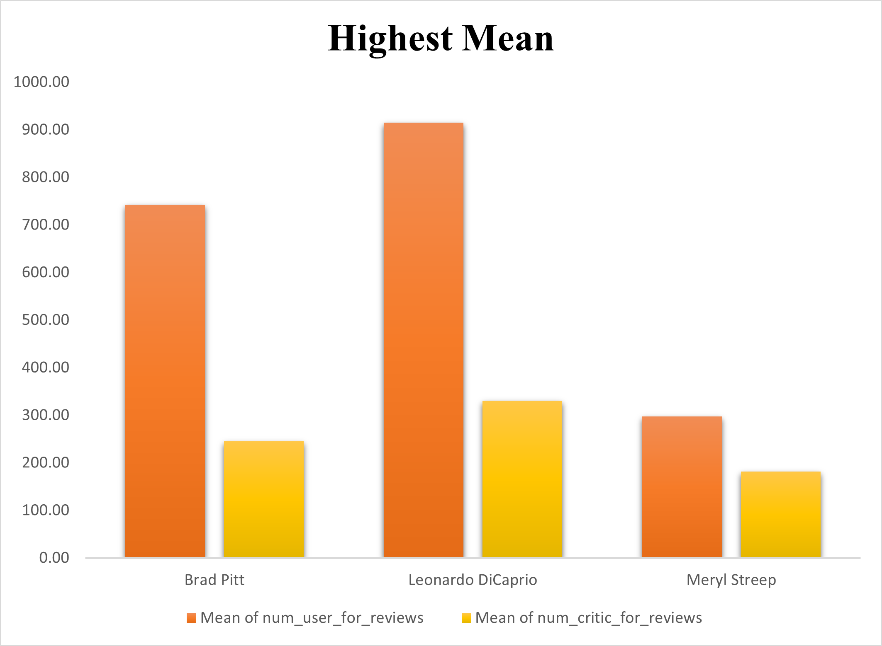

Slide 15
2. Voted users over decades

Slide 16
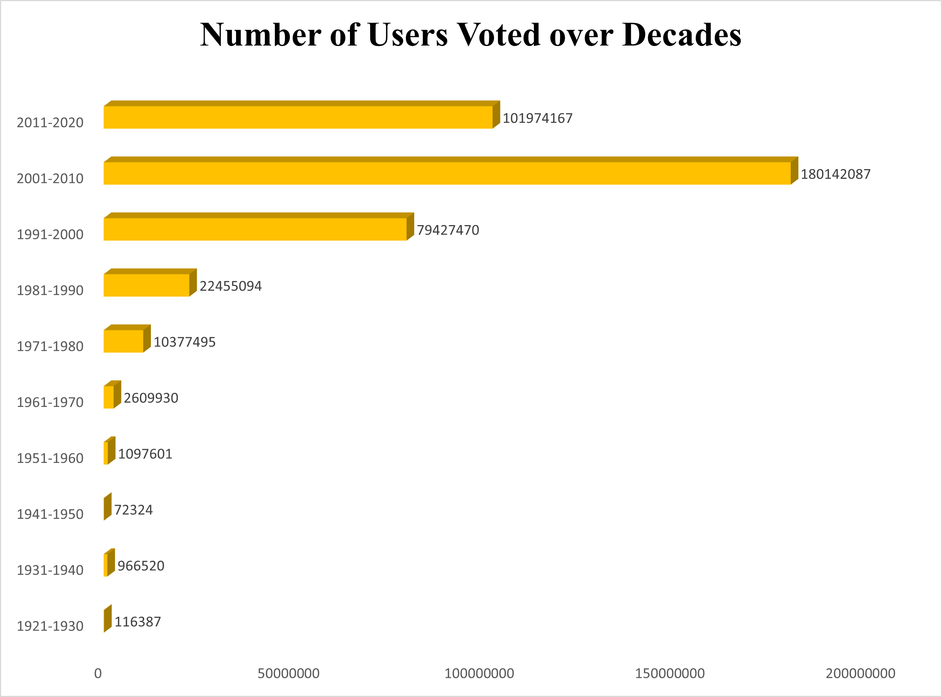

Slide 17
Results:
Thus, all the questions that where asked in the project have been provided with answer, data table and along with graphs.
From this project, I have learned how to clean data, manipulate data and about pivot tables and charts & graphs and techniques like sort, filter, pivot table, etc …

